Slide 1
Threads, IPC, Synchronization in Linux

Slide 2
THREADS
Chapter 12

Slide 3
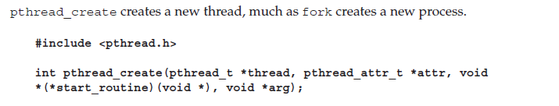


Threads

Slide 4
Simple Thread Example
#include<stdio.h>
#include<pthread.h>
#include<stdlib.h>
void * threadFunc1(void * arg){
int i;
for(i=1;i<=5;i++){
printf("%s\n",(char*)arg);
sleep(1);
}
}
void * threadFunc2(void * arg){
int i;
for(i=1;i<=5;i++){
printf("%s\n",(char*)arg);
sleep(1);
}
}
int main(void){
pthread_t thread1;
pthread_t thread2;
char * message1 = “I am thread 1”;
char * message2 = “I am thread 2”;
pthread_create(&thread1,NULL,threadFunc1,(void*)message1 );
pthread_create(&thread2,NULL,threadFunc2,(void*)message2 );
while(1);
return 0;
}

Slide 5
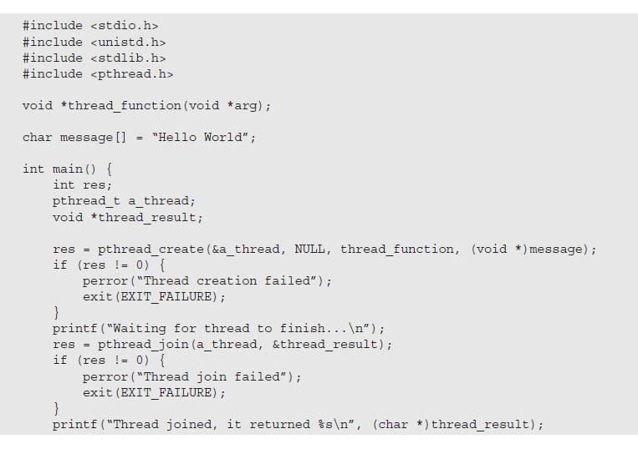
Thread Join

Slide 6
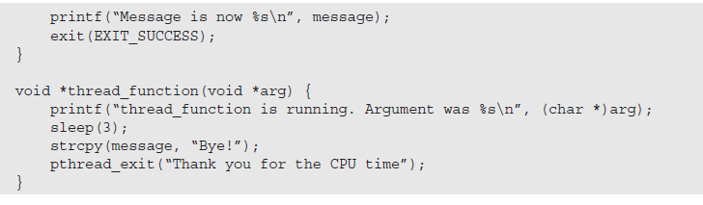
Thread Join

Slide 7
Semaphores
Chapter 14

Slide 8
Semaphores
A new variable type
a kind of generalized lock
First defined by Dijkstra in late 60s
Main synchronization primitive used in original UNIX
Semaphores are like integers, except
No negative values
Only operations allowed are up and down – can’t read or write value, except to set it initially

Slide 9
Semaphores
Operation “down”:
if value > 0 value-- and then continue.
if value = 0, process is put to sleep without completing the down for the moment
Checking the value, changing it, and possibly going to sleep, is all done as an atomic action.
Operation “up”:
increments the value of the semaphore addressed.
If one or more process were sleeping on that semaphore, one of them is chosen by the system (e.g. at random) and is allowed to complete its down
The operation of incrementing the semaphore and waking up one process is also indivisible
No process ever blocks doing an up.

Slide 10
Semaphores
Counting semaphore.
The value can range over an unrestricted domain
binary semaphore
The value can range only between 0 and 1.
On some systems, binary semaphores are known as mutex locks as they provide mutual exclusion

Slide 11
Controlling access to a resource
What if we want maximum m process/thread can use a resource simultaneously ?
Counting semaphore initialized to the number of available resources
Semaphore from railway analogy
Here is a semaphore initialized to 2 for resource control:
Non critical
Critical : 2 Cars permitted at a time
Non Critical
Value=2
Value=1
Value=0
Value=1
Value=0
Value=2

Slide 12
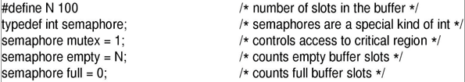
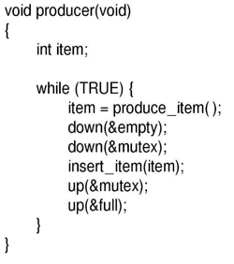
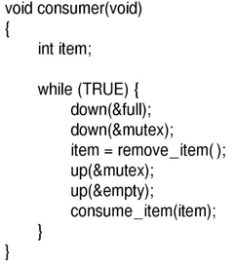
Producer & consumer

Slide 13

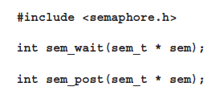

Semaphores in Thread

Slide 14
Class Work

Slide 15
Class Work: Producer & consumer

